Slide 1
2020 Census – Counting on Libraries North Carolina Library Association
Bob Coats
Governor’s Census Liaison
North Carolina State Data Center Office of State Budget & Management,
Demographic & Economic Analysis Section
Bob.Coats@osbm.nc.gov

Slide 2
You May Have Heard …
Notes:
HOPEFULLY, you’ve heard of the US Census!
It’s coming soon ... April 1, 2020.
There are a lot of moving parts to the Census, and it’s easy to get confused. So let’s talk about what the Census is, why it matters, what we can expect, and when we can expect it.

Slide 3
Census Origins
Rome
Census from censere – “to estimate”
Servius Tullius, 6th King of Rome, 575-535 BCE
Censor was a magistrate responsible for counting the population, supervising public morality, and overseeing government finances
Notes:
Since you folks are information scientists, I thought it would be nice to give you some Census background information

Slide 4
Census Origins
US
Required by Article 1, Section 2 of the US Constitution
1790 First US Census, conducted by Thomas Jefferson
Census task count everyone once, only once, and in their usual place of residence

Slide 5
Census Impact
Our Voice (Representation)
Census is required by the US Constitution
Count every resident, once, and in the right place
Apportionment and Redistricting
Our Tax Dollars (Funding)
$1,623 per person, per year in Federal Funding to NC based on Census data in FY2015
About $200 per person, per year in state funding based on Census data
Our Future (Planning)
Largest survey in the US providing reliable, comparable data
Vital for business and local government service
Notes:
These are the core points of why the Census is important to every community.

Slide 6
Decennial Census is a Foundation
Geographic Foundation
Census Redistricting Establishes the smallest geographic units (census blocks) used for redistricting
Participant Statistical Areas Survey (PSAP) Defining statistical boundaries for the next decade including tribal areas and Census Designated Areas
Boundary Annexation Survey (annual) Verifying boundary changes
Demographic Foundation
Largest and most granular survey Foundation for other Census estimates, models, and surveys throughout the decade
Notes:
Since the decennial Census is the largest survey – and the largest peacetime mobilization – done in the US, the geographic and demographic data that comes out of the Census become the foundation for the next decade’s data.

Slide 7
Census Data at Work
Classroom size
Infrastructure Workload
Service Audience
Notes:
Census are the base for estimated classroom size planning.
Whether applying for a Community Development Block Grant, projecting future Medicare/Medicaid eligibility population, or preparing to open a business – Census data informs your decisions
Accurate data on the workload local water, sewer, power, and roads are serving in vital for managing community growth, and the Census measures this workload.

Slide 8
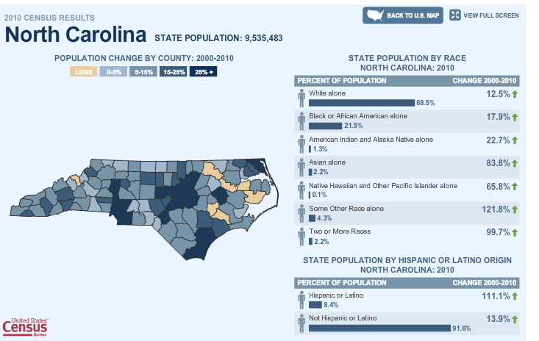
Notes:
North Carolina has seen a lot of growth over the past few decades, but here’s a graphic showing our change from the 2000 Census to the 2010 Census.
I know you’re saying, “This info is as ancient as Servius Tullius, 6th King of Rome and father of the Roman Census.”
Way to pay attention!

Slide 9
North Carolina Population vs. Other States
9th Largest State at 10.4 Million
4th Largest Population Gain (848,000 people), April 2010 to July 2018
 | Population Estimate |  |  | Change, 2010-2018
Geographic Area | April 1, 2010 | July 1, 2018 |  | Numeric | Percent
United States | 308,758,105 | 327,167,434 |  | 18,409,329 | 6.0
California | 37,254,523 | 39,557,045 |  | 2,302,522 | 6.2
Texas | 25,146,114 | 28,701,845 |  | 3,555,731 | 14.1
Florida | 18,804,580 | 21,299,325 |  | 2,494,745 | 13.3
New York | 19,378,124 | 19,542,209 |  | 164,085 | 0.8
Pennsylvania | 12,702,873 | 12,807,060 |  | 104,187 | 0.8
Illinois | 12,831,572 | 12,741,080 |  | -90,492 | -0.7
Ohio | 11,536,757 | 11,689,442 |  | 152,685 | 1.3
Georgia | 9,688,709 | 10,519,475 |  | 830,766 | 8.6
North Carolina | 9,535,736 | 10,383,620 |  | 847,884 | 8.9
Michigan | 9,884,117 | 9,995,915 |  | 111,798 | 1.1
Source: U.S. Census Bureau, Population Estimates, Vintage 2018.
Notes:
Rank moved up from 10th in 2010. (surpassing Michigan – which moved down from 8th place)
13th fastest population growth (after DC, UT, TX, FL, CO, ND, NV, AZ, WA, ID, SC, OR, NC)

Slide 10
North Carolina Population Change – Historic and Projected
Source: US Census Bureau, Decennial Censuses; OSBM Population Projections, 2018 Vintage.
April 5, 2018
Office of State Budget & Management
Notes:
48 Years ago this week – 1970 Census
Pop ½ size that it is today (10.3 million)

Slide 11
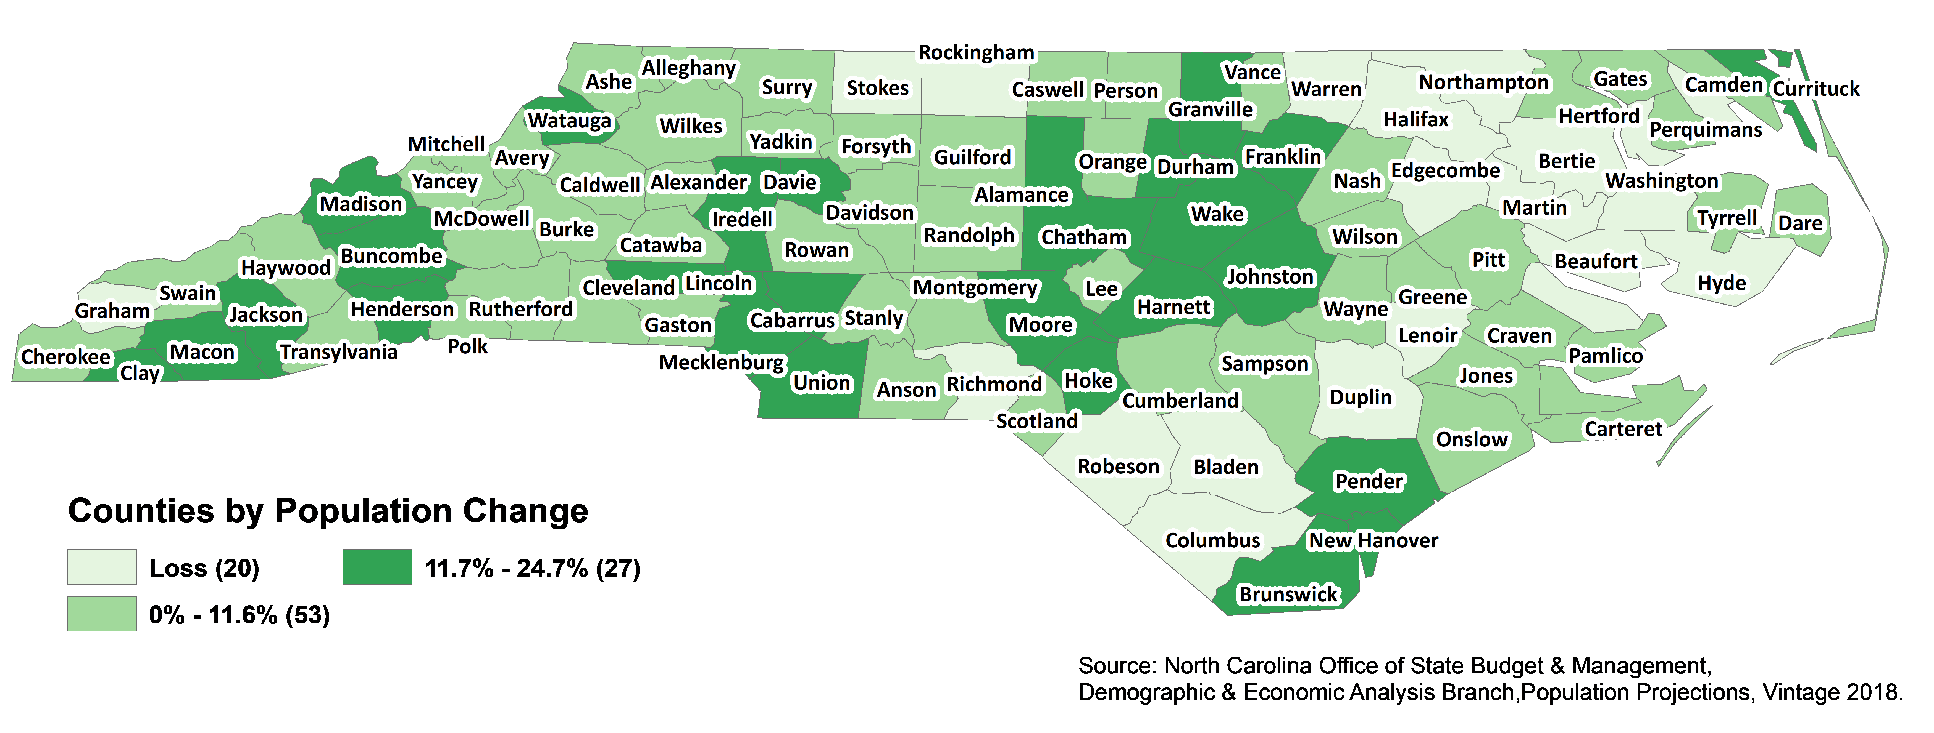
Projected Population Change, July 1, 2018 – July 1, 2028
State Change: 11.6% (1.2 Million People)
Notes:
2018-2028 1,206,865 11.6%

Slide 12
What Can We Expect?
Census Mailings in March 2020 Internet, phone, and paper response options will be available
April 1, 2020 is Census Day Non-response Follow Up will begin in April
State Populations must be reported by December 31, 2020 These numbers determine apportionment of seats in Congress
Redistricting Files will be delivered in Spring 2021
Census Count Challenges can be submitted through 2023 Challenges can only be submitted by local/tribal governments
Metropolitan Statistical Areas will be redefined in 2023
Notes:
Let’s talk about a very general timeline for the 2020 Census.

Slide 13
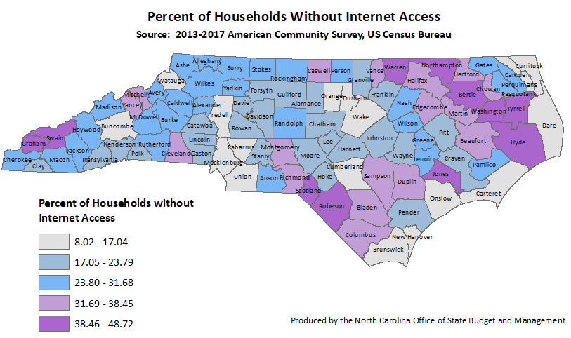
Internet Access in North Carolina
Statewide – 766,632 (19.79%)
Notes:
The 2020 Census is the first US Census to use the internet as the primary response option.
Internet access is a mixed bag across the country and in North Carolina.
While phone, paper, and personal interviews are still available – libraries can help with internet access!

Slide 14
Census is …
SELF Reported Information
Responses are how the respondents identify
A Government Operation with a BIG Local Impact
Participating supports your county, town, neighborhood
Intimidating
Confidentiality is protected by law (Title 13 US Code)
Coming soon
How do we make the Census a success for us
Notes:
It’s important to understand some – and this is very much the tip of the iceberg – of the realities/concerns of the Census.
It’s self reported data. There’s no right or wrong answer. You respond how you identify – in terms of age, race, gender, ethnicity. It’s up to you!
It’s a government operation, and that can be scary. Census is an investment in the future of your community. We invest now, or pay later with poor data, insufficient funding, etc..
It’s very important to recognize that individual Census data is NOT shared with the courts, law enforcement, immigration, or anyone. There are stiff penalties for breaking the confidentiality protections.
The Census is coming. We can make it work for us or we can suffer the consequences of not participating.

Slide 15
PARTICIPATION – EVERYONE COUNTS!

Slide 16
Local Governments
Preparation
Boundary Annexation Survey (BAS)
Local Update of Census Addresses (LUCA)
New Construction
Participant Statistical Areas Program (PSAP)
Promotion
Knowledge of local barriers to participation
Trusted local faces
Complete Count Committees
Notes:
A lot of the early geospatial preparations for the Census rely on contact with Local Governments. BAS, LUCA, New Construction, and PSAP work directly with local governments or their designated liaisons.
But all the preparation is wasted if there is poor participation in the Census.
Local governments – and I expand this to mean local LEADERSHIP – know the unique challenges to census participation in their communities. They’re also trusted familiar faces that are really important to encouraging Census participation.
Census Bureau is reaching out to Local Governments to form CCCs, but ANY leader/group can form a CCC .

Slide 17
You Can Help!
Notes:
You’re busy!
But you’re not alone
And you don’t need to reinvent the wheel

Slide 18
Libraries – Trusted Community Hubs
Awareness, Information, Connectivity
Internet access Simplify the process as much as possible
Community awareness Posters Factsheets Census visibility - logos
Questionnaire Assistance 2010 Census – Questionnaire Assistance Centers (QACs) 2020 Census – Census Questionnaire Assistance (CQA) Internet (chat), phone, and POSSIBLY MQAC
Notes:
Census Bureau Partnership Specialists have been meeting with local governments and other community organizations as trusted local voices to establish Complete Count Committees.
Libraries are established trusted community hubs. You SHOULD be integral to 2020 Census promotion and … since this is the 1st internet Census … Census RESPONSE.
Library staff are not expected to be Census experts. You provide access and information but NOT GUIDANCE ON RESPONSE.
ALA has written a letter on Questionnaire Assistance Centers. The 2020 Census plan is to provide Questionnaire Assistance via internet chat and phone. The Census Bureau requested 2019 appropriation for “Mobile Response Initiative” for Mobile Questionnaire Assistance.
Libraries can increase awareness of the 2020 Census by displaying Census posters, logos, and factsheets.
Ask for any information that would be helpful!

Slide 19
Here’s Where to Start
Start/join a Complete Count Committee Stay connected with the NC CCC
Involve agency partners - staff and customers
Leverage your existing resources Add the NC Census Logo to your website and email taglines Link to census.nc.gov Use #MakeNCCount and @NCCensus on social media Include Census logo, reference, or content on standard work processes (mailings, documents, listservs, blogs, etc.) Add Census message at conferences
Notes:
If you’re fired up and want to be very proactive, FANTASTIC! The NC CCC can you help you form your own CCC and get going.
Too busy? Ask the NC CCC for resources or messages to help!
But don’t miss the “low hanging fruit.”
Inform your employees – posters in break rooms and taglines
You don’t need to invent a product, you can use existing resources to leverage the NC Census message.
Add the NC Census logo to your website and link to census.nc.gov . See nc.gov for an example!
If you’re using social media include the NC Census logo or use #MakeNCCount and @NCCensus
Include the Census message/logo on existing communications – add the NC Census logo on the back of billing or on the “this page intentionally left blank” part of PDF reports
Mention the Census importance at conferences – NCDOT btw Census data tells us how much traffic we can expect on our roads. Better data means better roads. So please be counted!

Slide 20
Participation Risk
Recent Migration
Language
Race
Literacy
Preschool Age
Poverty
Notes:
Assessing, Planning, Budgeting, and Communicating can happen at the same time and in an ongoing cycle, but to give us some structure I’m starting with assessment. If you’ve already identified a few key members of your CCC, this is a good place to start.
Every community is different and faces its own unique combination of Census participation risks.
Local knowledge of these unique risk factors is one of key values of CCCs
But there are some consistent factors that have shown to be consistent risk factors for everyone.

Slide 21
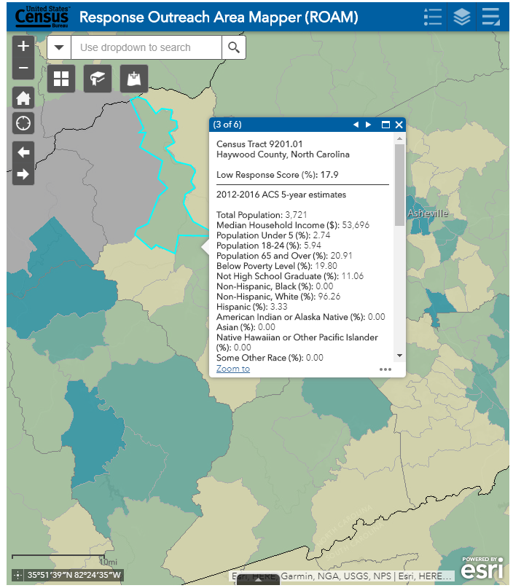
ROAM – https://www.census.gov/roam
Notes:
The Research Outreach Area Mapper – ROAM from here on out – is based on the latest Planning Database data and includes a Low Response Score ( a predicted mail non-response rate) to the tract level.
ROAM is searchable by address, county, place, congressional district, ZIPcode, tract, etc.. Or you can just zoom or pan around the map.
ROAM maps the Low Response Score. Clicking on a tract displays the numeric LRS and detailed data from the Planning Database.
ROAM doesn’t display all the Planning Database detail though.
ROAM is a great tool for CCCs to begin their Census risk assessment or target their activities.
Here’s an example of a ROAM report for Haywood County Tract 9201.01
Note the Low Response Score of 17.9%
The supporting data points are facets of the hard-to-count populations

Slide 22
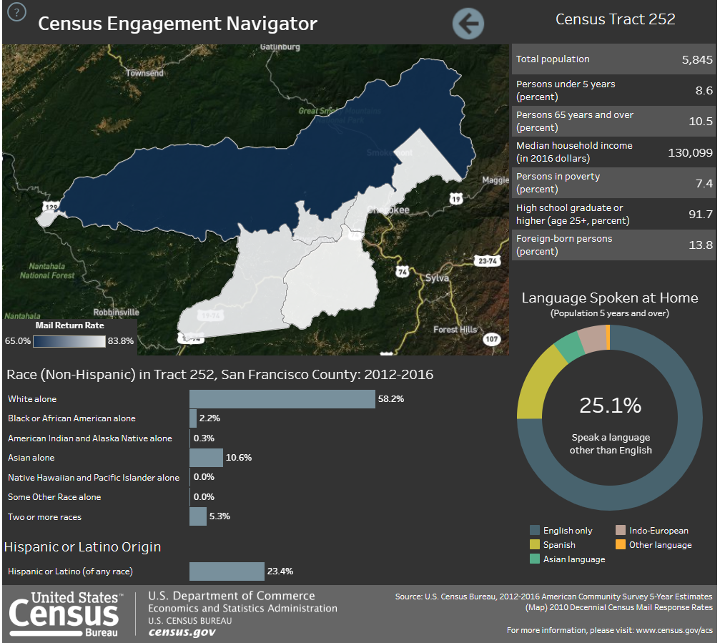
Census Engagement Navigator https://www.census.gov/library/visualizations/interactive/engagement.html
Notes:
The Census Engagement Navigator – I’ll call it “Navigator” – is based on the latest Planning Database data like ROAM, but the Navigator does not show a Low Response Score ( a predicted mail non-response rate). Navigator shows the 2010 Census mail response rate without a 2020 prediction.
Navigator allows users to see data at the State, County, and Tract levels.
Navigator displays a dashboard of Planning Database data, and allows users to view narrative profiles including charts of tract level data.
Navigator is also a great tool for CCCs to begin their Census risk assessment or target their activities.
Using both ROAM and Navigator will give CCCs a good idea of their risk areas. The Planning Database complete data will provide the highest level of assessment data.
Here’s an example of a Navigator report for Haywood County Tract 252.
There’s no Low Response Score in Navigator.
The dashboard highlights facets of the hard-to-count population

Slide 23
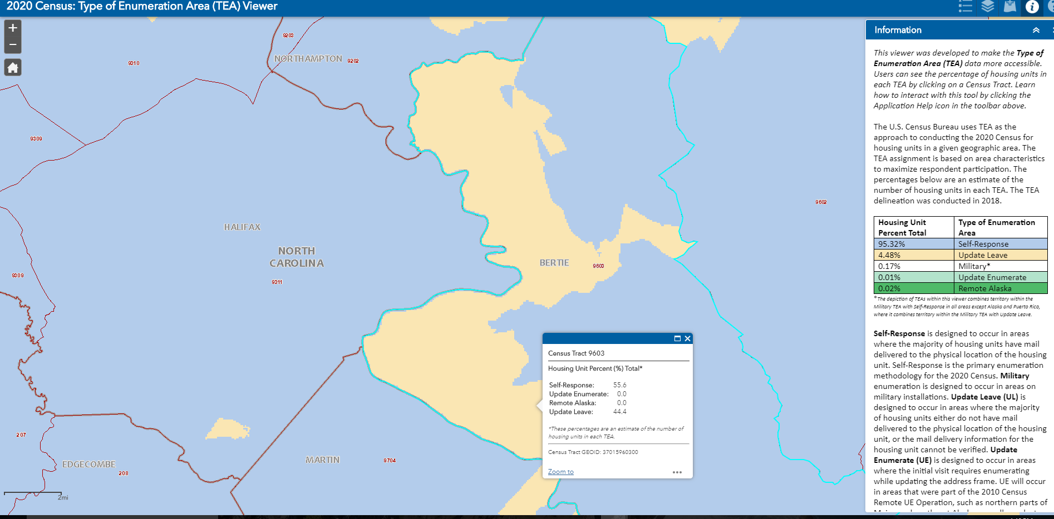
Type of Enumeration Area (TEA) Viewer
Notes:
The Census has evolved with technology over time. The 2020 Census will be the first to allow internet response!
There will be other options to respond to the Census including paper forms, and there will be different ways that households are counted/enumerated.
Most households will receive a postcard in the mail, but some areas will have questionnaires left at their door.
To what type of enumeration will happen in your area, the Census Bureau has provided the Type of Enumeration Area (TEA) Viewer.
Here’s an example of Bertie County, and we can see that Census Tract 9603 is almost evenly split between Self Enumeration and Update Leave.

Slide 24
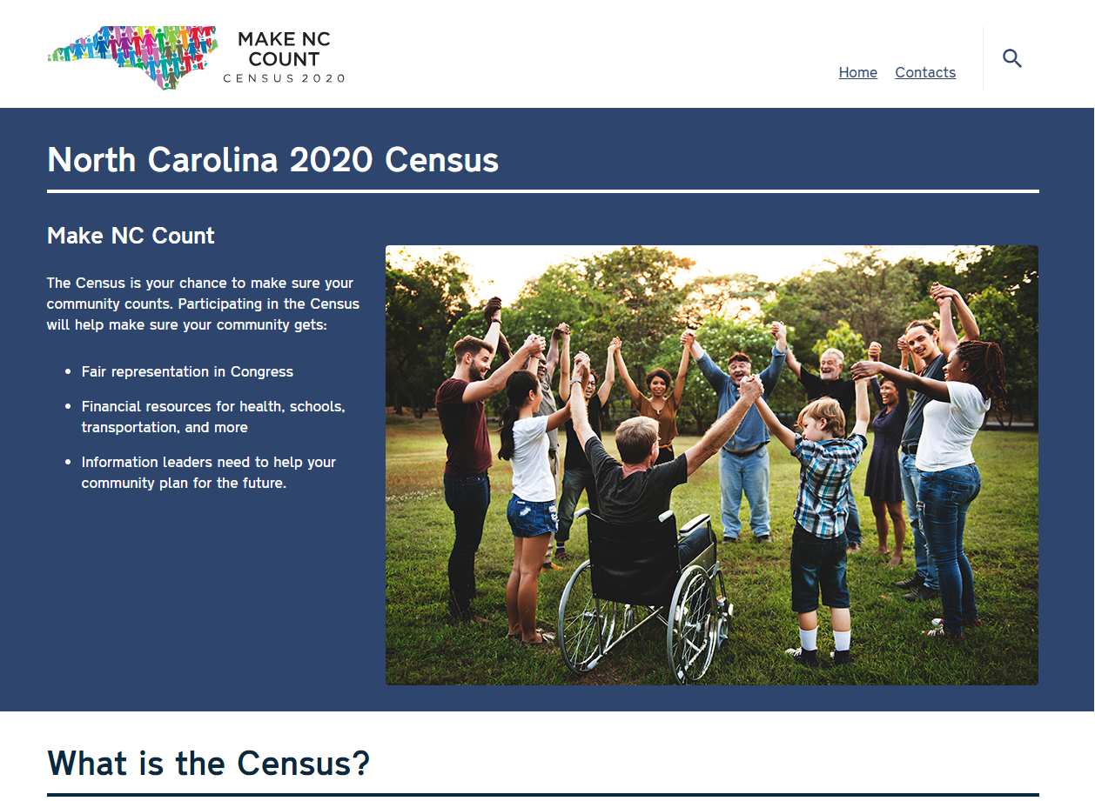
NC Census Website – https://census.nc.gov
Notes:
We have a home on the web to coordinate interest.
We plan to expand the site to include dynamic content – blogs, video, maps – aimed at every facet of North Carolina.
The NC CCC and feedback we receive will drive that content.
How should we grow? How should we speak to NC?

Slide 25
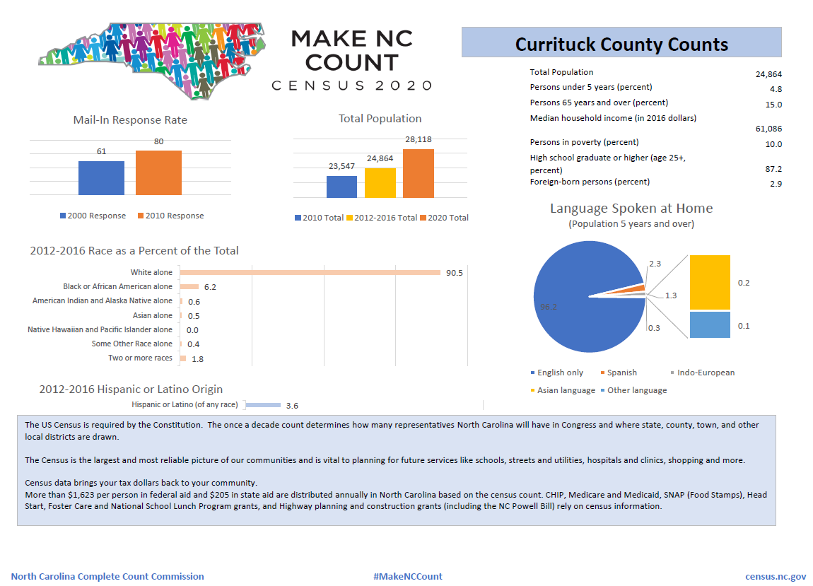
North Carolina County Profiles
Notes:
This is an example of a county profile produced by the NC CCCC. Profiles for all NC counties as well as a dynamic Census dashboard will be available soon through the NC Census website.

Slide 26
Census Toolkit https://www.census.gov/partners/toolkit.pdf
Notes:
The Census Bureau has an online Community Outreach Toolkit.
The toolkit helps determine what barriers you may face and ways to address those barriers. The toolkit also includes worksheets, factsheets, and even templates for Census stickers.
It’s a great, FREE, resource for any Census partners!

Slide 27
Getting to the Data
Notes:
We’ve talked a lot about the importance of Census data – preparation, promotion, and collection of Census data – but how do you GET to the data?

Slide 28
American FactFinder
Factfinder.census.gov
Notes:
American Factfinder is a legacy data tool.
There’s a lot of data there, but it is being retired

Slide 29
Census.gov
Data.census.gov
Notes:
Data.census.gov is the Census data tool for the future.
All data releases from here on will be in this format
Differential Privacy!

Slide 30
Contact
Bob Coats (984) 236-0687 Bob.Coats@osbm.nc.gov
Governor’s Census Liaison, North Carolina State Data Center Demographic and Economic Analysis Section NC Office of State Budget and Management
Notes:
Ooooo … look at that spiffy Localized Census Logo!

