Slide 1
Census Resources & Data: Government & Business Perspectives. Part 2
NCLA’s GRS & BLINC Webinar
June 16, 2020: Webinar
Presenter: Jennifer C. Boettcher, Georgetown University

Slide 2

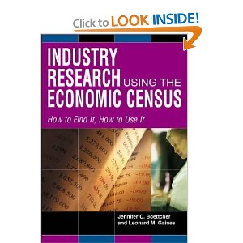
Jennifer C. Boettcher
Jennifer C. Boettcher and Leonard M. Gains. Industry Research Using the Economic Census. Greenwood : Phoenix, AZ. 2004
M.B.A., Georgetown University, Washington, D.C., 2005
M.L.S., State University of New York, Albany, N.Y.,1992
B.A., University of New Hampshire, Durham, N.H., 1987
ALA RUSA BRASS Member since 1991
ALA GODORT member since 1990
Georgetown University 1997-present
Founder of Business Information Finders (BIF) and Capital Area Business Academic Librarians (CABAL) in DC
2013 Emerald Research Grant: Zombie List (reanimated business sources)
Seeking contributors: boettcher.georgetown.domains/HisBusColl
2010 Gale Cengage Learning Award for Excellence in Business Librarianship

Slide 3
Economic Census Structure
Census, not a survey- All Business
  Administrative records- Social Security & IRS
Every five years with years ending in 2 and 7
  Legal Basis Title 13, United States Code (U.S.C.), Section 9, 131, 224, and 225. Copies retained in respondents’ files are immune from legal process.
2017 Reference -- 2018 Collection -- 2019 Production
Core data (Geographic)
Number of establishments
  Value of sales, receipts, revenue, shipments, or business done
  Annual payroll
  Number of employees
Notes:
online questionnaires, and most often used are the administrative records.
NOTE: Core Data
Number of establishments
Income of business
Annual Payroll (largest expense in a business)
Number of employees
Look at the forms sent out

Slide 4
Review of what we learned in 2019 GRS event
Economic Census NOT Population & Housing Census
North American Industry Classification System (NAICS)
  How are Industries classified
North American Product Classification System (NAPCS)
  How are Products classified
Cigarettes are Products and Convenience Stores are the Industry
Understanding the levels of Geography in Economic Census
Going beyond the Geographic Reports into the Series Reports
  Subject Reports coming out in November 2020
Review the survey instrument for the industry of interest.
  https://bhs.econ.census.gov/ombpdfs

Slide 5
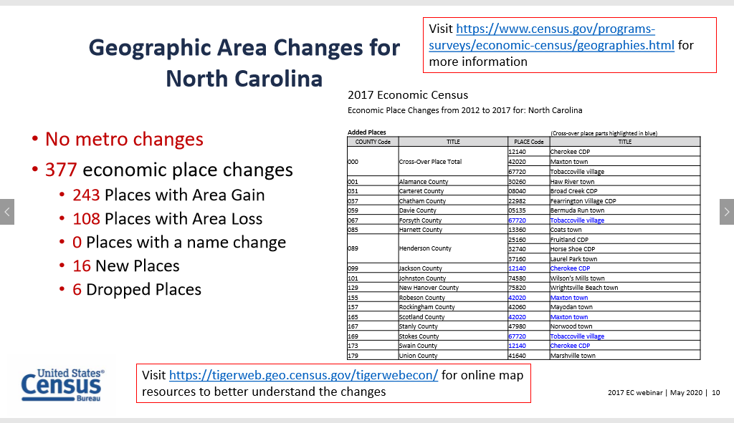
links don’t work

Slide 6
Changes with the 2017 Economic Census
New disclosure rules -- new privacy rules will result in the establishment count being suppressed when fewer than 3 or when the other statistics are suppressed.
  You will be seeing a lot more of D
NO Place-level data for the Manufacturing sector and the NAICS and geographic levels published for other sectors may be adjusted based on data quality and privacy issues.
  less geographic details
Introduction of the Annual Business Survey (ABS) -- The Survey replaces three existing surveys: the five-year Survey of Business Owners (SBO) for employer businesses, the Annual Survey of Entrepreneurs (ASE), and the Business Research and Development and Innovation Survey for Microbusinesses (BRDI-M).

Slide 7
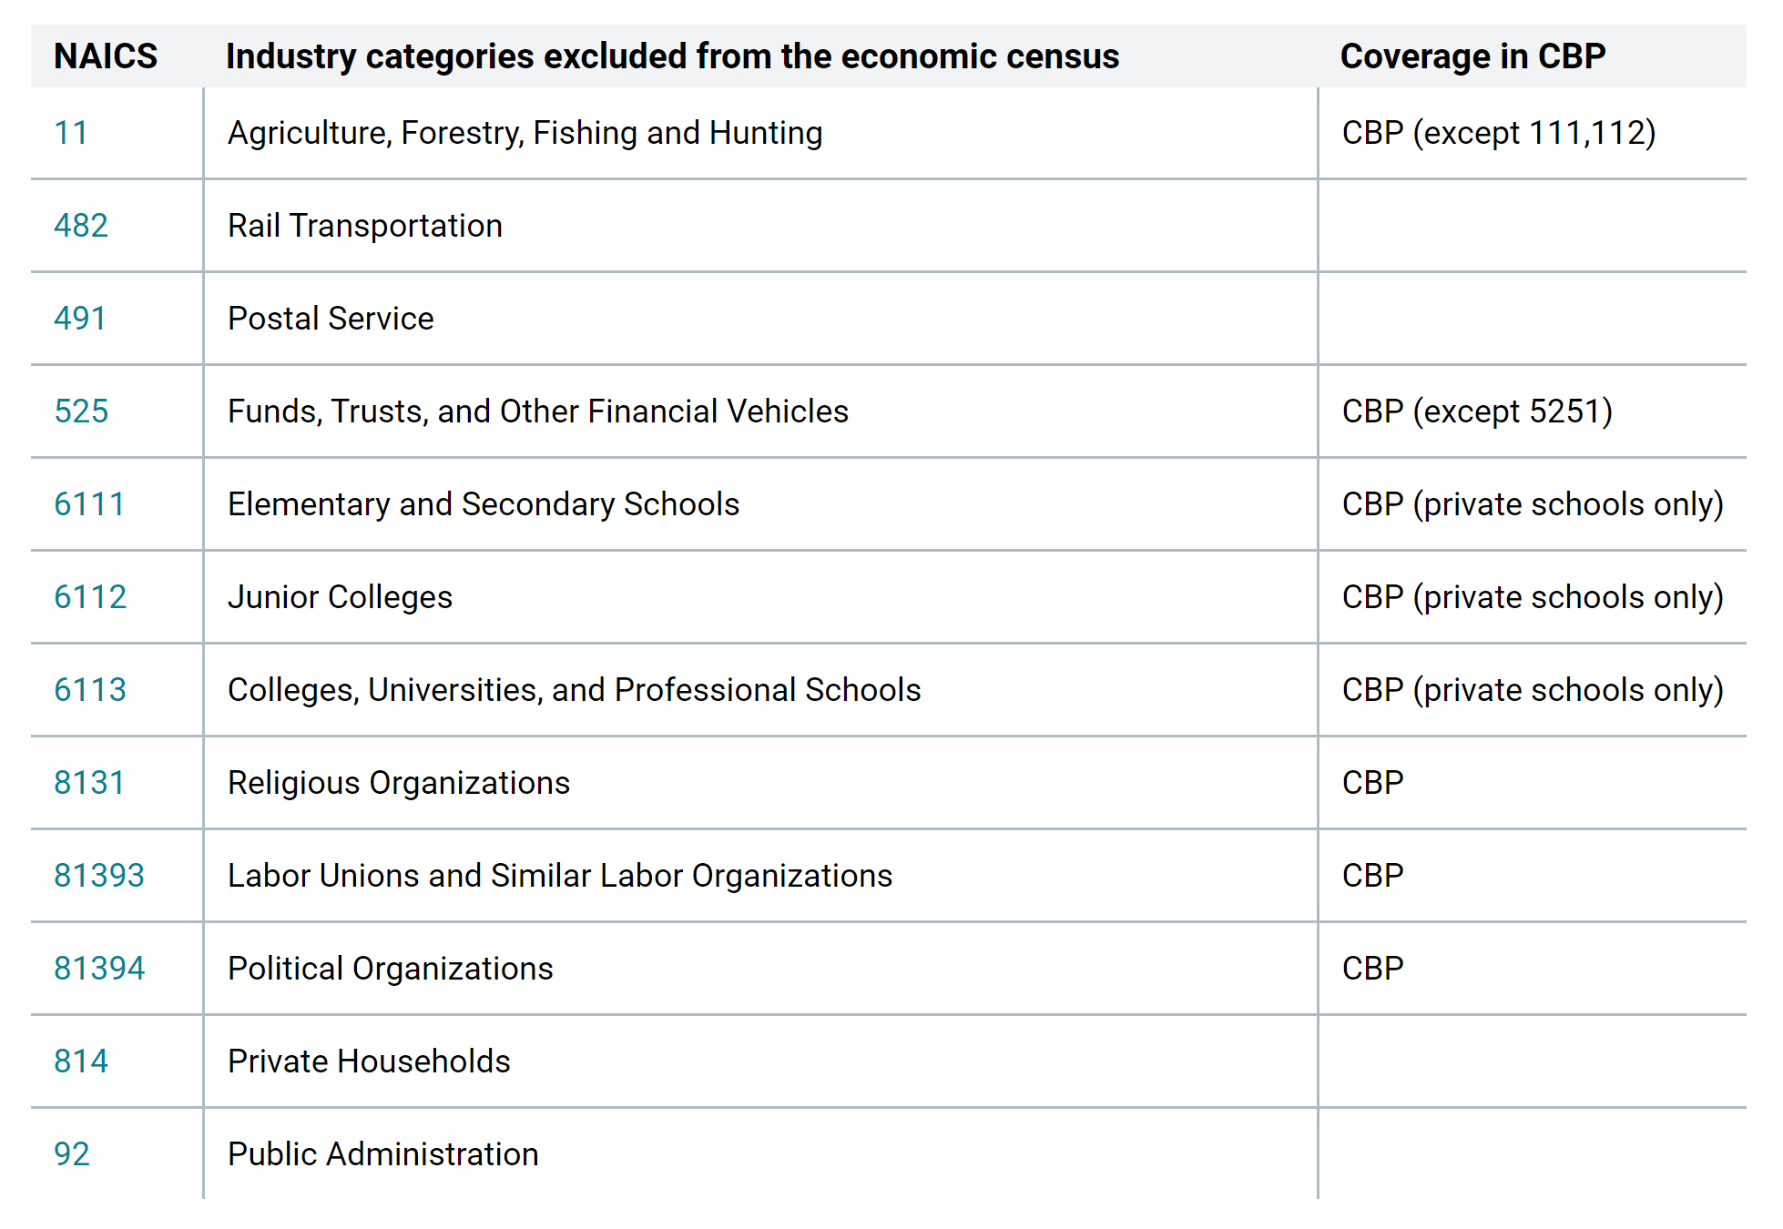
What is not covered in the Economic Census

Slide 8
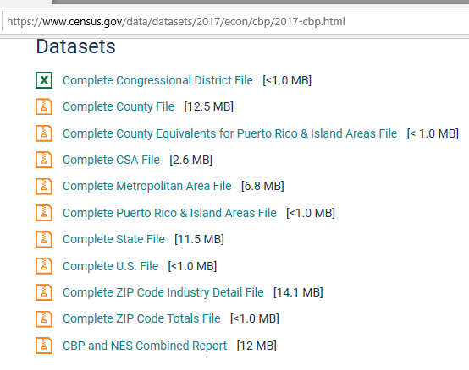
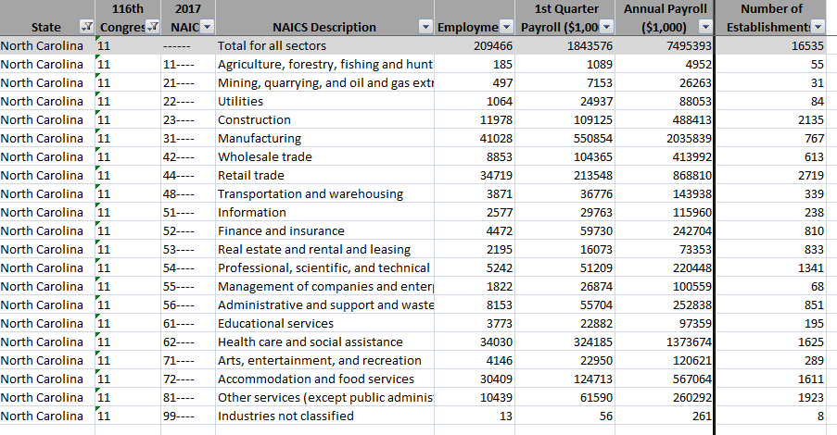
Country Business Pattern

Slide 9

Indicators from Census Bureau
County Business Patterns (ZIP, Congress, MA, Islands, State, United States)
Advance Monthly Sales for Retail and Food Services (MARTS)
New Annual Business Survey (ABS)
Annual Survey of Manufactures (ASM)
Business Dynamics Statistics (BDS)
New Business Formation Statistics (BFS)
Foreign Trade Programs and Products
Medical Expenditure Panel Survey (MEPS)
Nonemployer Statistics (NES)
Longitudinal Employer-Household Dynamics (LEHD)
Quarterly Services Survey (QSS)
Quarterly Financial Report (QFR)
Rental Housing Finance Survey (RHFS)
New Small Business Pulse
All Census Programs
Notes:
The Census Bureau publishes a number of the Principal Economic Indicators, like
■ Monthly retail sales,
■ Manufacturers’ shipments, inventories and orders
■ International Trade in Goods and Services...
■ and the brand new Quarterly Services Survey

Slide 10
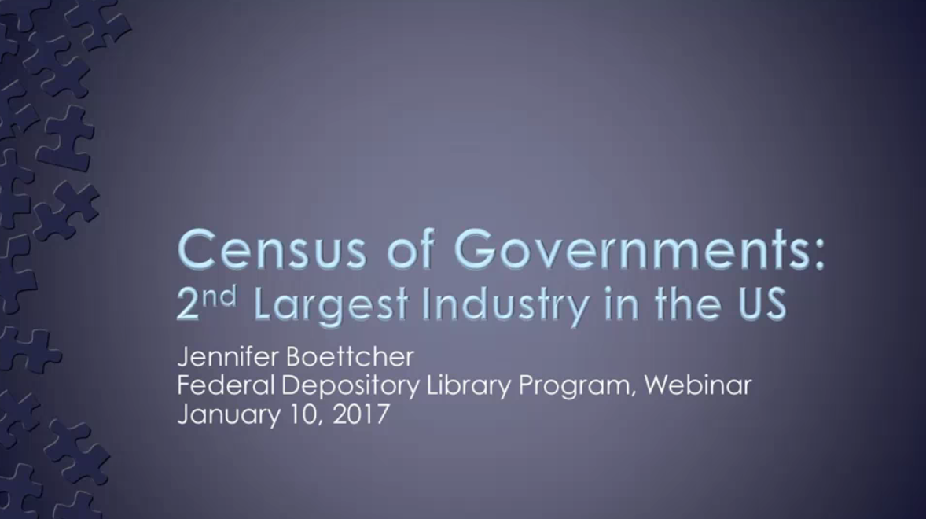
Census of Governments and Public Schools

Slide 11
Common Mistakes
Nonemployer not in ANY Economic Census reports
Totaling up the columns
Not going beyond the core geographic data points
Not realizing tax exempt data is separate in
  Professional, Scientific, and Technical Services
  Educational Services
  Health Care and Social Services
  Arts, Entertainment, and Recreation
  Other Services

Slide 12
Business WITH the U.S. Federal Government
Procurement
Disasters Assistance
Authoritative site for Assistance Listings, Wage Determinations, and Contract Opportunities (beta.sam.gov)
  Old: Federal Business Opportunities (FedBizOpps.gov) to Replace the Commerce Business Daily (CBD)
  Old: Catalog of Federal Domestic Assistance (CFDA)
Disaster Assistance
Federal and State Benefits
Search Catalog of Federal Domestic Assistance (CFDA)

Slide 13
Federal Government Information is Business
Executive Branch
Congressional Branch
Regulations
Data, API
Data, Statistics or Indicators
Press releases or Trade press or Bulletin
Handbooks or Fact Books
Department’s Reports
Industry Reports or Surveys or Review
State of the Industry and Outlooks
Geographic specific
New Technology and direction
Forthcoming laws
Committee reports/prints
Congressional Research Section
Library of Congress, Reading Rooms
Government Publishing Office
Judicial Branch
Interpreting laws
Courts, transcribes
Courts, defendants

Slide 14
Major Sources of Social Science information in the US Government
Census (Demographics, Public Finance, Manufacturing, Retail, Wholesale, Construction, most other industries)
Labor
Companies
Economic
Federal Budget Projections
Taxes
Spending
Social Security
Consumer/Financial Literacy
Production Costs
Justice
Banking
Mortgage
Trade
Transportation
Telecommunications
Education
Libraries and Museums
Economic Analysis

Slide 15
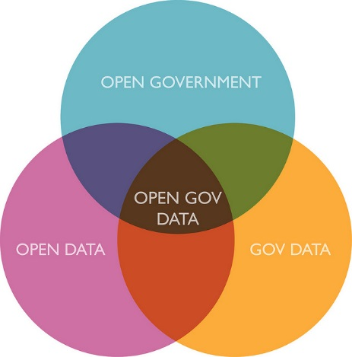
Major Sources of Natural Science information from the US Government
Agriculture and Fisheries
Defense
Health
Energy
Environment
Intellectual Property
Land Management and Minerals
Pharmaceuticals
Science & Engineering
Weather
https://www.flickr.com/photos/notbrucelee/6897137283/in/photostream

Slide 16
Major International Data Sources
By Topic
By Country
  http://data.un.org
  Social & Economic- World Bank
  Financial & Economic- International Monetary Fund
  Human body- World Health Org
  Labor- International Labour Org
  Telecommunications- International Telecommunications Union
  Governance- Transparency International
  Developed Countries- Organisation for Economic Co-operation and Development (OECD)
National Statistical Offices
  More data available in national language
  Some charge for access
  Citizens of that country might have free access
National Repositories/Archives
  Historical
  Datasets

Slide 17
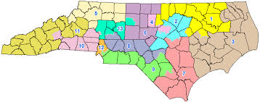
Have Fun
Create puzzle maps of our state with 3-D printers
  Have a gerrymandering parties
Host Wikipedia events with the Historical Society to track the industries in your communities
Give quiz questions to the Chamber of Commerce and other clubs
  Which industry is the largest employer in … or Which county has the most hotels?
Have a release party with your State Data Center
Dedicate a computer just to entrepreneurships with Census Business Builder and relevant links
Arm citizen journalists with quarterly tax and annual school data
YOUR idea here – send them boettcher@georgetown.edu

Slide 18
Learning more
Government Sources
Numerical Data
FDLP Academy
Accidental Government Librarian
Data Academy from Census
Inter-university Consortium for Political and Social Research (ICPSR) repository

Slide 19
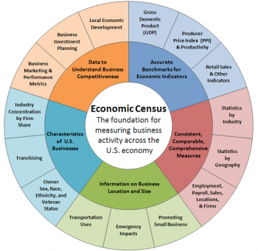

boettcher@georgetown.edu
202 687-7495
Twitter: @jenny.wombat
These slides are licensed under a Creative Commons Attribution-NonCommercial 4.0 International License

Slide 20
NEWS
February 26, 2020 OMB ask for permission to kill the Standard Industrial Classification (SIC). Long live the North American Industry Classification System (NAICS) 85 FR 11120, parts V and VI
  V. OMB Statistical Policy Directive No. 8, Standard Industrial Classification of Establishments The ECPC is soliciting public comments at the request of OMB on the advisability of formally updating Statistical Policy Directive No. 8, Standard Industrial Classification of Establishments, and seeking comments on the proposed text of the update.
  VI. OMB Statistical Policy Directive No. 9, Standard Industrial Classification of Enterprises The ECPC proposes elimination of Statistical Policy Directive No. 9, Standard Industrial Classification of Enterprises.

Slide 21
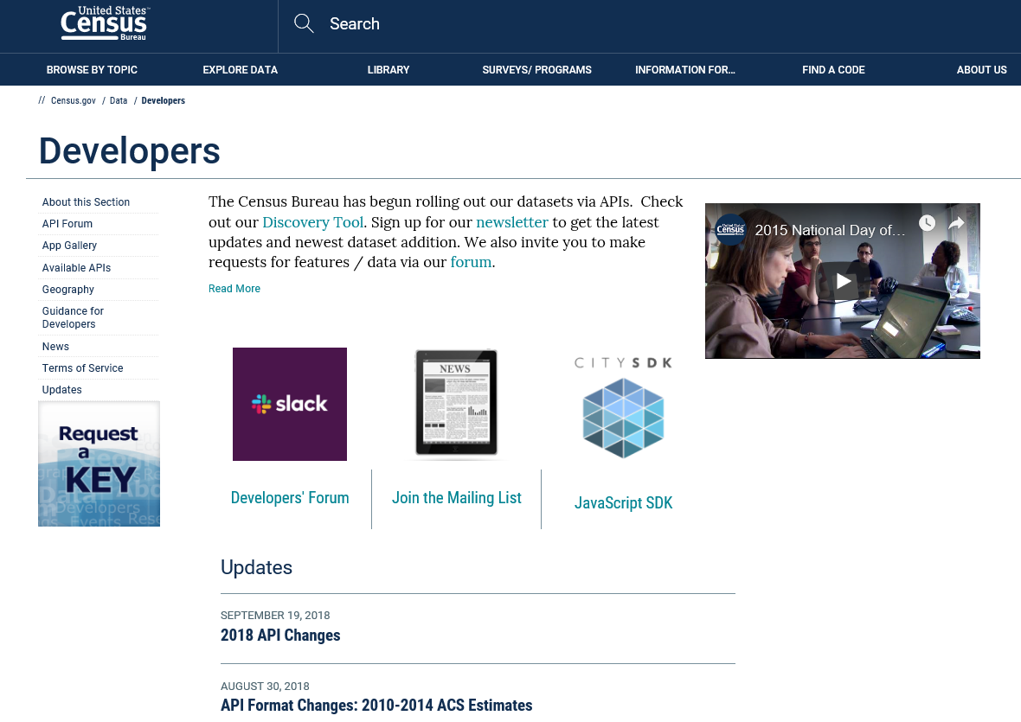
The Census Developers Site/APIs
Steps:
Request a Key
Sign up for our Newsletter and Forum
Browse the Discovery Tool
Review the Updates, etc.
https://www.census.gov/developers/

Slide 22
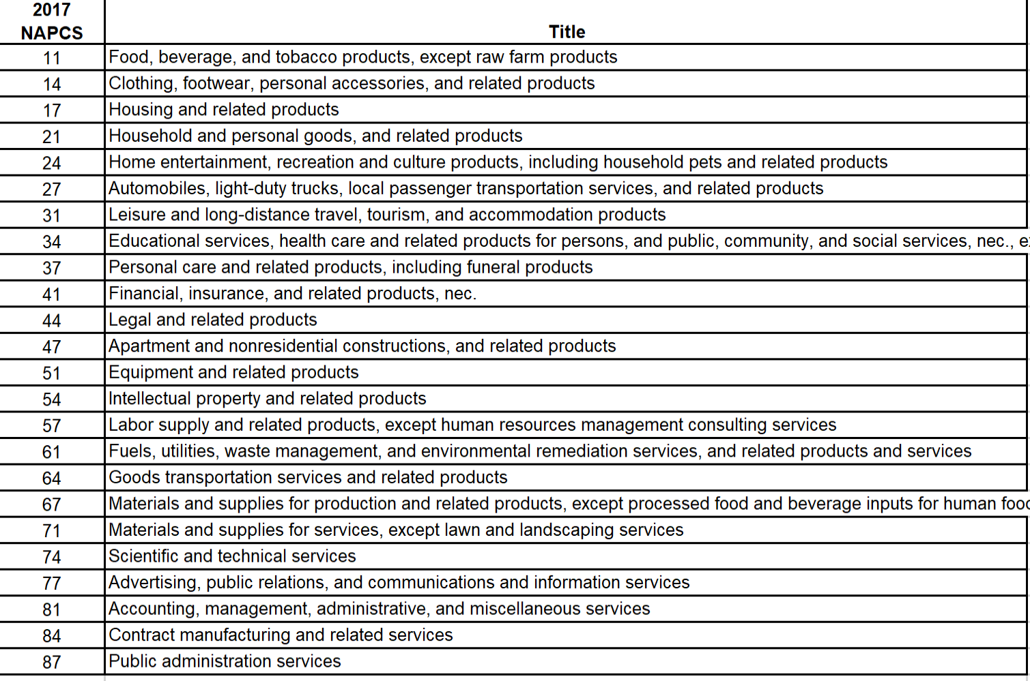
NAPCS Structure

Slide 23
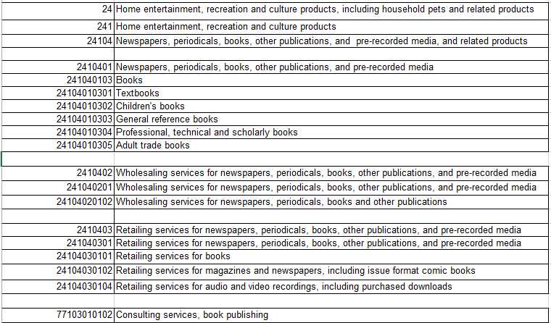
NAPCS: Books

Slide 24
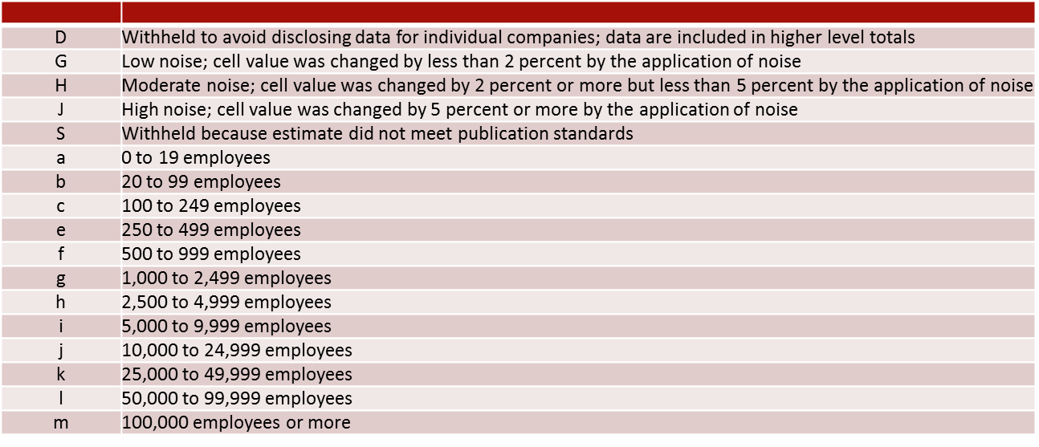
Abbreviations and Symbols
https://www.census.gov/programs-surveys/susb/about/glossary.html

Slide 25
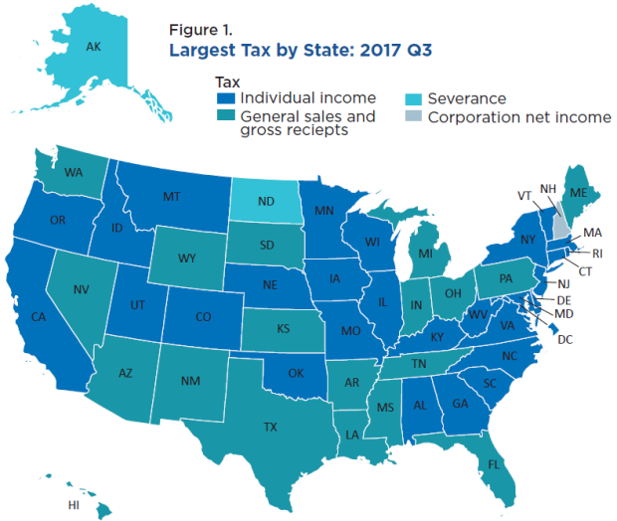
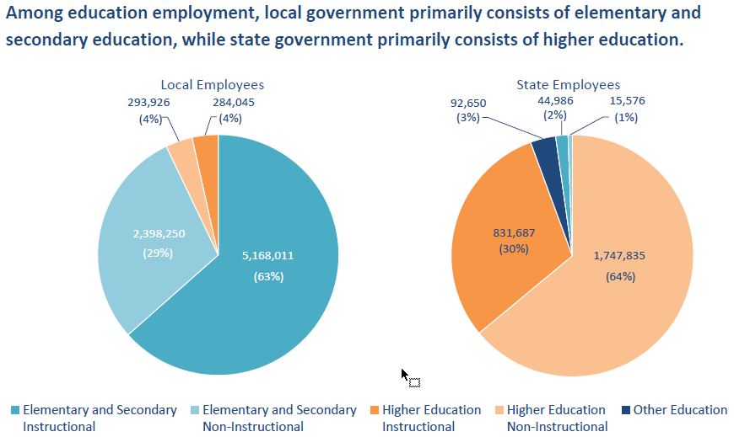
Public Sector (Governments)
5 surveys that provide economic statistics about state and local governments
Serve as public-sector counterpart to private sector data
Response is voluntary
Virtually no confidentiality restriction – data is public record
Core Program Content
  Organization and Structure
  Government Employment
  Government Finances
Released on American FactFinder, Excel files, and other Census tools

Slide 26
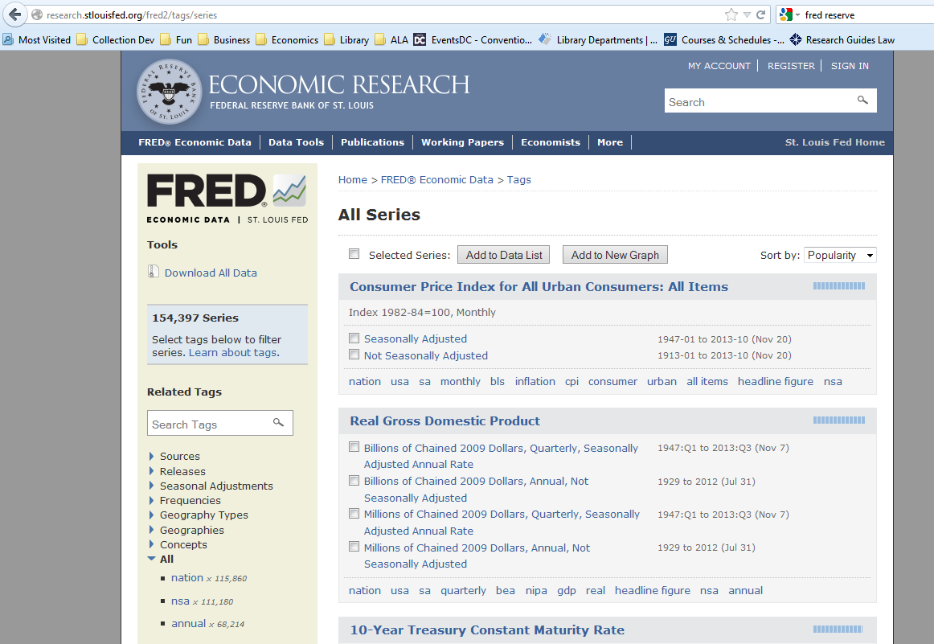
Economic – Macroeconomic
Federal Reserve Board’s FRED
    http://research.stlouisfed.org/fred2

Slide 27
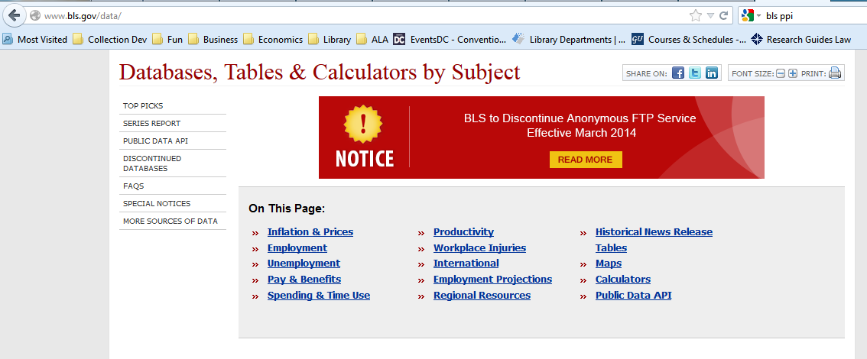
Economic – Sector Inflation
Bureau of Labor Statistics- Producer Price Index
    http://www.bls.gov/data

Slide 28
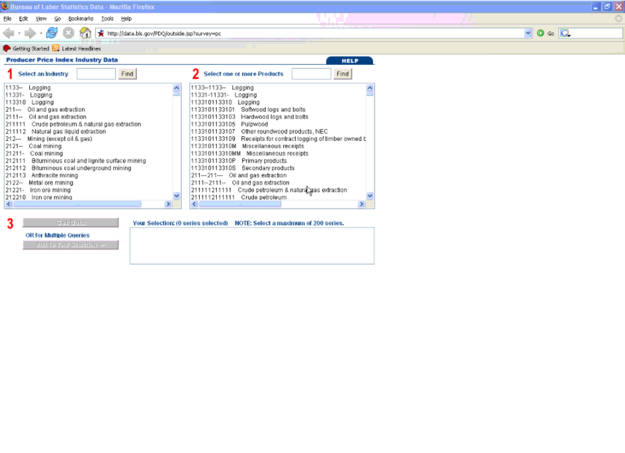

Slide 29
One Statistical Office in US: Why Not?
1. Privacy: The Privacy Act of 1974, Confidential Information Protection and Statistical Efficiency Act of 2002 (CIPSEA), and Statistical Policy Directive No. 1 (2014) require agencies to ensure that the collection and maintenance of citizens' data is accurate, confidential, and within legal restrictions. With different offices having access to those records, there would be less possibility of everything being leaked.
2. Security: Along the lines of fewer offices having access to data records. The more servers that hold the data, the safer it is. The times when an exchange of information is necessary laws and regulations among departments allow to protect access to data.
3. Integrity: The income you report to IRS might be different from what you report to the Census Bureau.
4. Methodology: Sometimes data must have a higher number of people questioned so the accuracy will be better; different methods of collection or sampling may be required.
5. Popularity: Anything being done by the government has a political dimension, especially funding for employees and for modernizing and updating technology, attractiveness of the research, and repetition of statistical programs by agencies.

